Slide 1
Wairau Hospital

Slide 2
Wairau Hospital

Slide 3
Wairau Hospital Webinair
Presenters:
Dr Ashton Blake-Barlow, PGY1 House Officer
Dr Eric Munro, PGY1 House Officer
Loretta Matheson, RMO Team Lead

Slide 4
About Wairau Hospital
Wairau Hospital is a 65 bed hospital and is the base hospital for the region servicing a population of approximately 50,000 people
Wairau is easily accessible to Kaikoura, Picton, Wellington, Nelson and Christchurch.

Slide 5
Recruitment Process
Mandatory Letter
Interviews are available throughout the year leading up to the DHB advising of their selection
Consideration of ACE scoring, CV, references
Have an interest/connection to area
Be able to be part of a small team and help each other out

Slide 6
Positions Available in PGY1 Year
5 PGY1 positions available.
Can take further PGY1’s throughout the year. Late starts negotiable.
Runs available: General Medicine (3), AT&R/Ophthalmology/Gen Med, General Surgery/ENT, General Surgery/Urology, Orthopaedics, Relief in 3rd/4th Quarters.

Slide 7
Positions Available in PGY2 Year
All of available PGY1 runs plus:
Community – Hospice, Urgent Care or GP
Emergency/Anaesthetics
O&G/Paediatrics
General Relief

Slide 8
The Best things about the Hospital
No Registrars
Great support from Consultants
Huge potential for growing independence
Small friendly team
Many opportunities to practice procedures/assist in theatre.
Fabulous province - Lifestyle

Slide 9
The average week
Generally get away at 4 most days
Approx. 1 long day per week and one weekend in 4.
Protected Teaching on Wednesday and Thursday.
Approximately 5 nights a quarter you can volunteer to be on back up- paid on call and if called in paid for a minimum 4 hours

Slide 10
Wairau Hospital PGY1 Video
PGY1 Video

Slide 11
Orientation Week
4 days orientation
Generally 1st day with Nelson PGY1 intake – district wide information
Further 3 days include a day shadowing on the wards, CORE course one day and valuable time with depts for e.g. Pharmacy, Radiology.

Slide 12
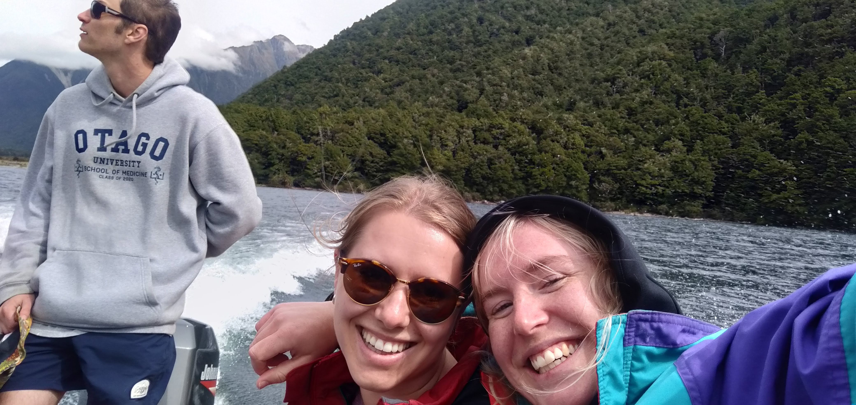
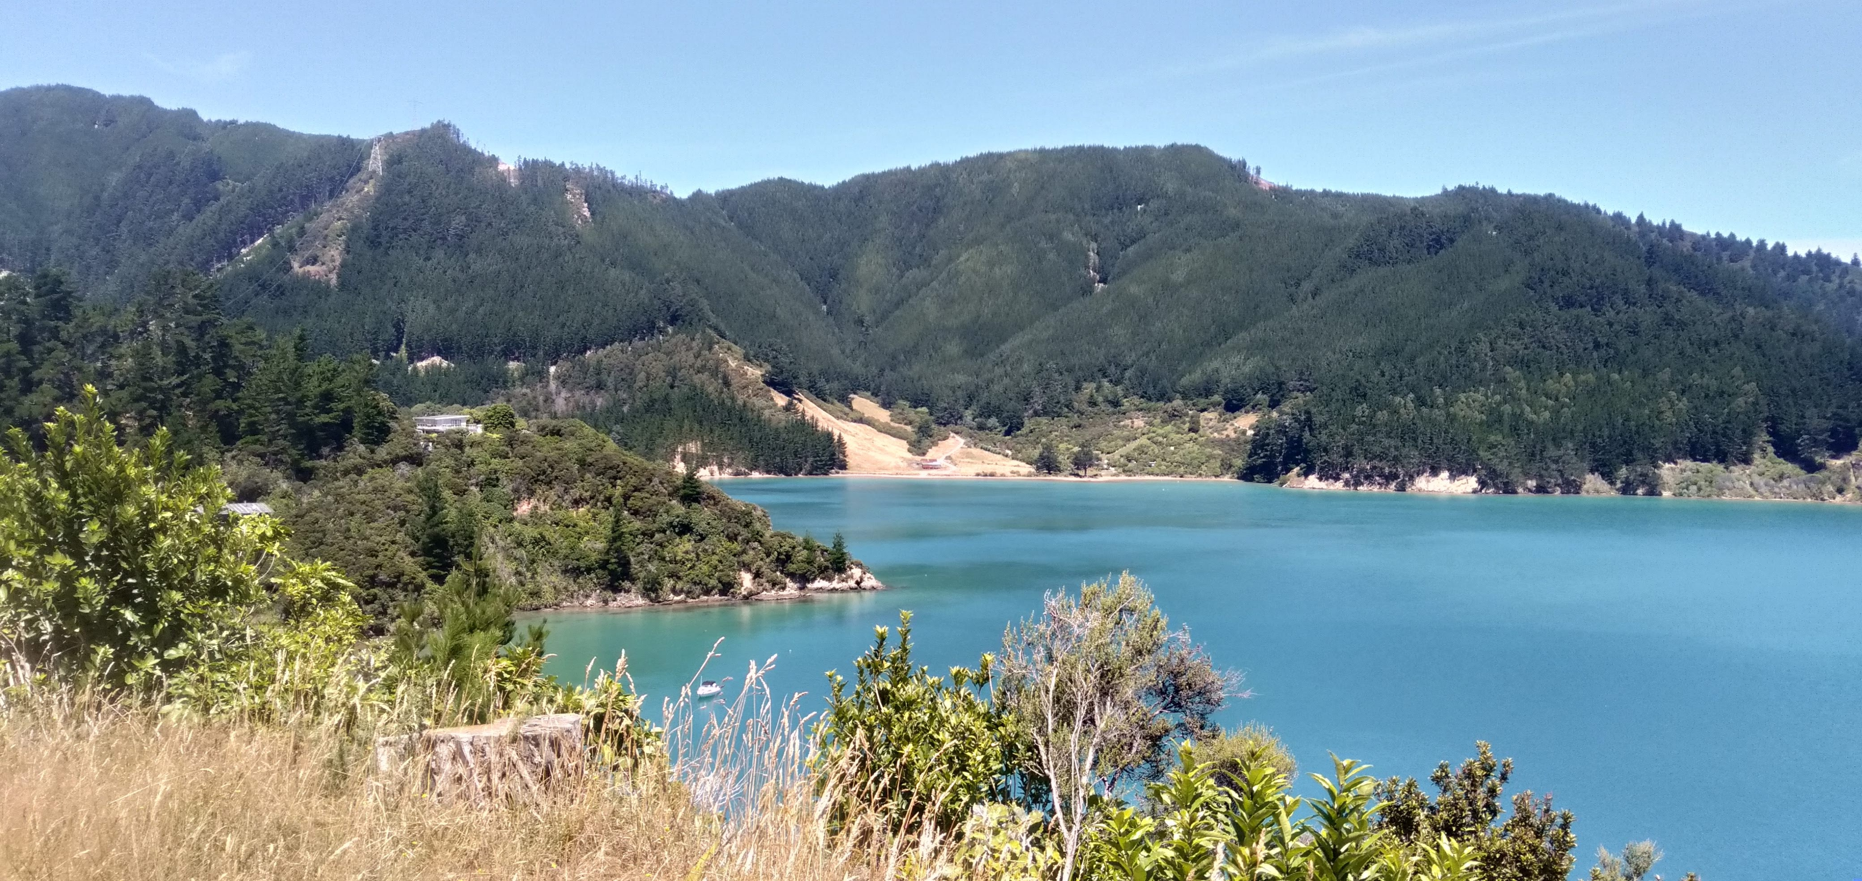
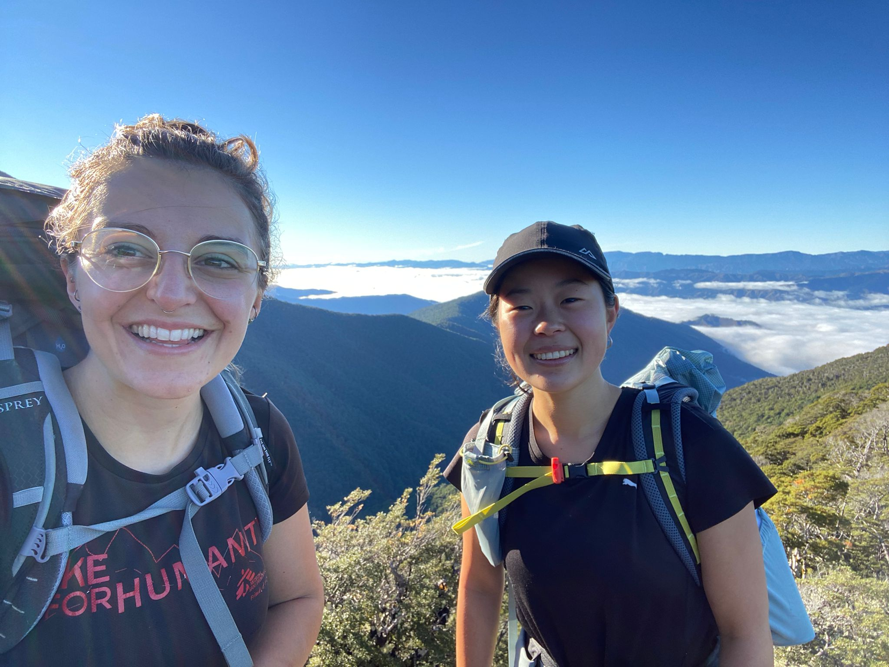
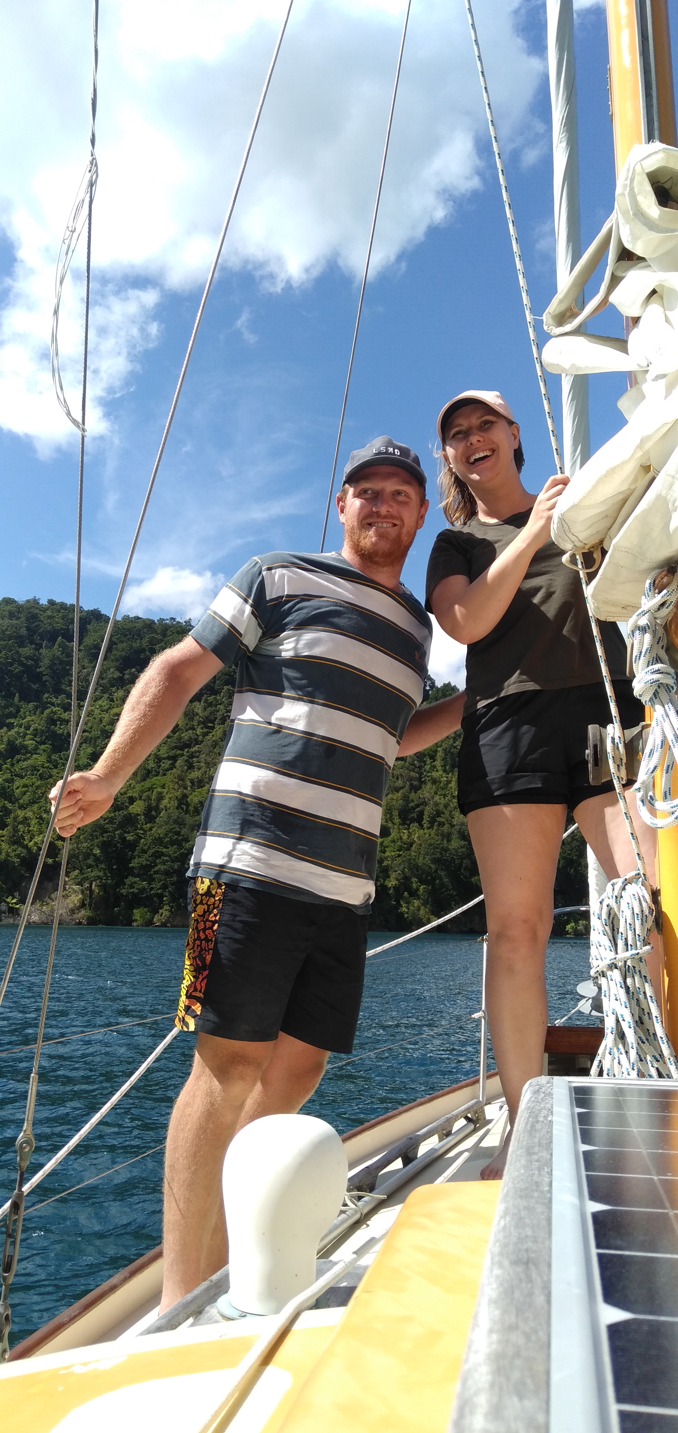
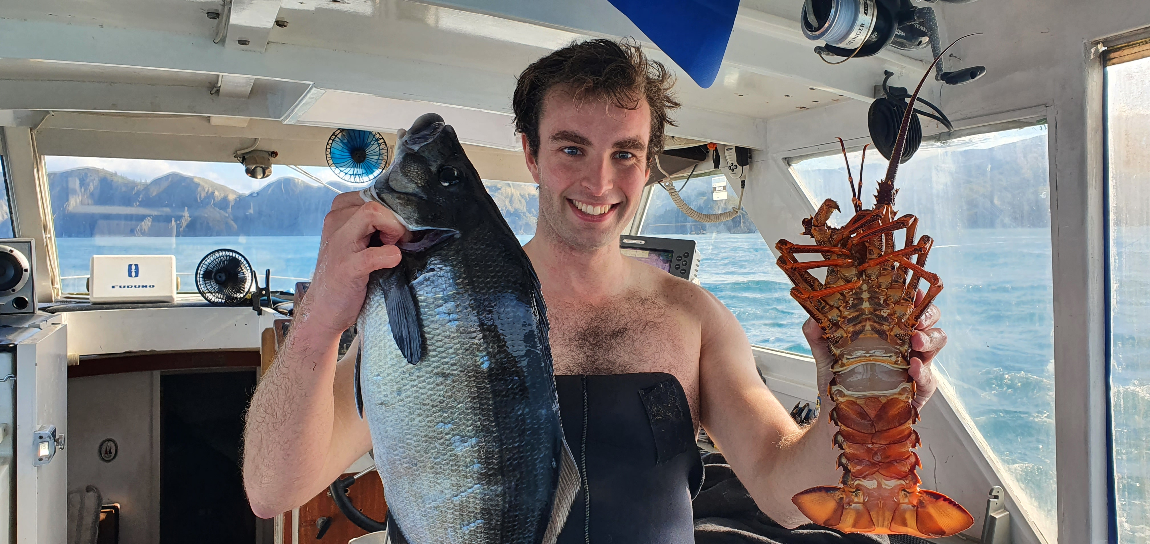
Working at Wairau

Slide 13
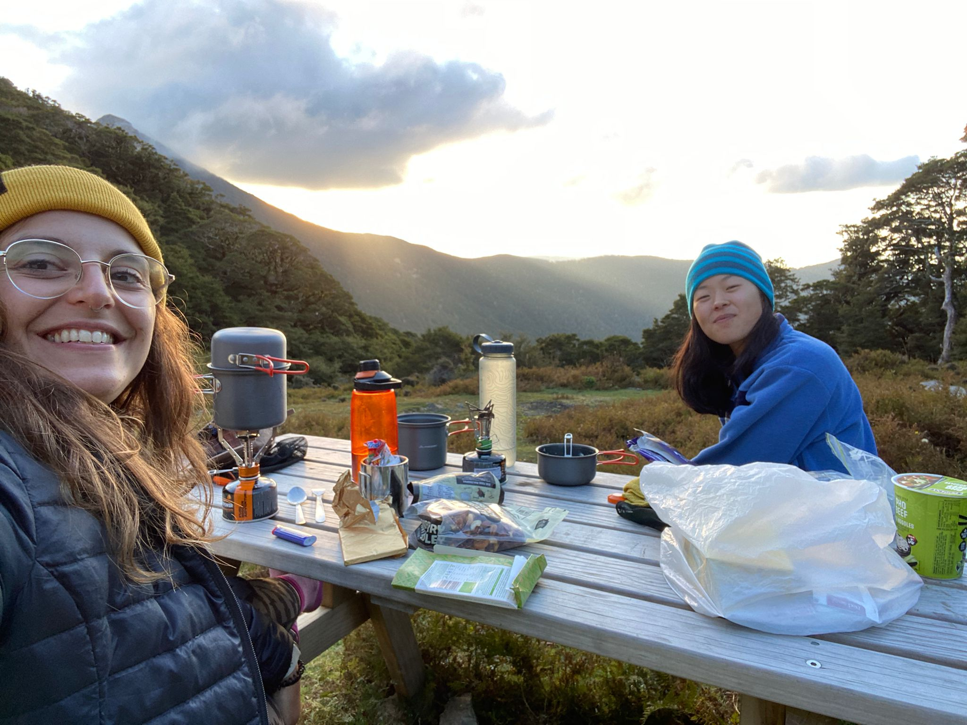
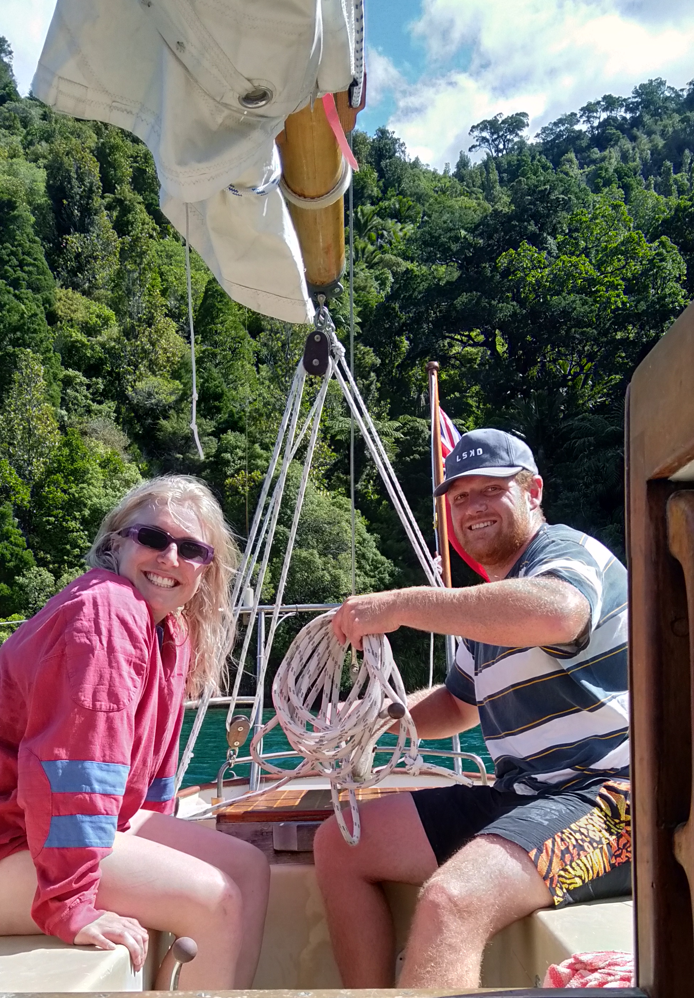
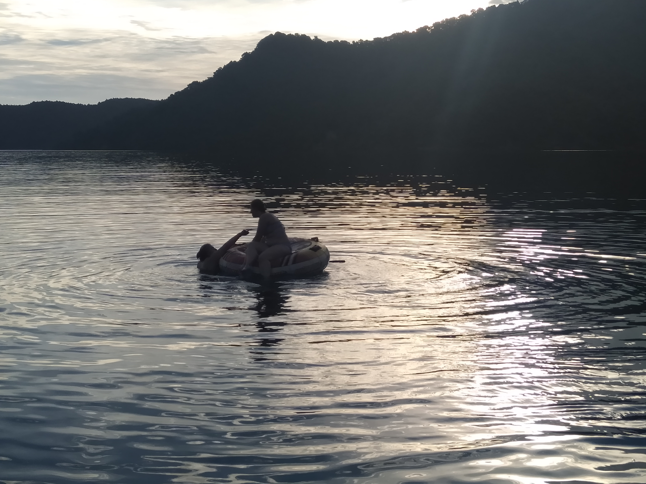
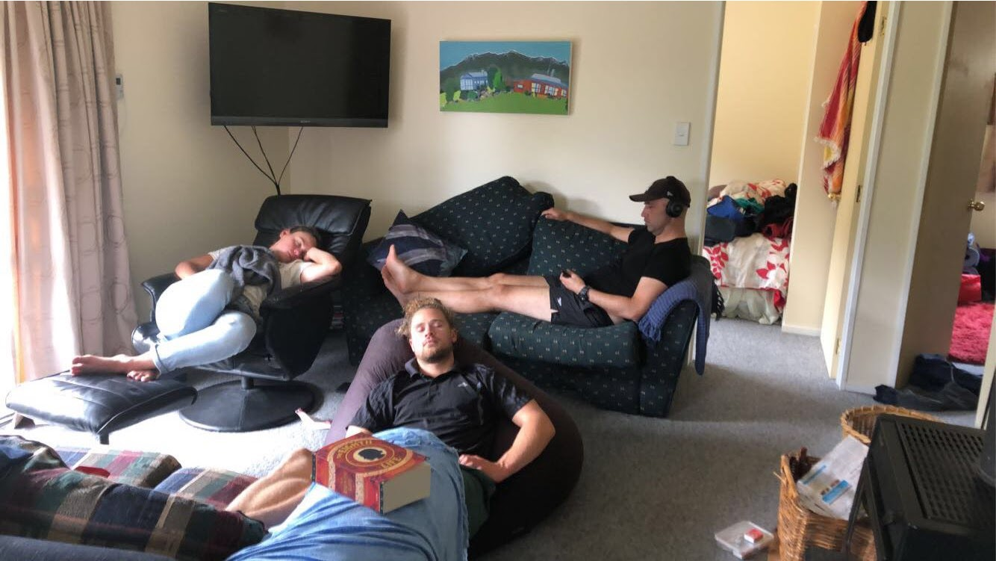
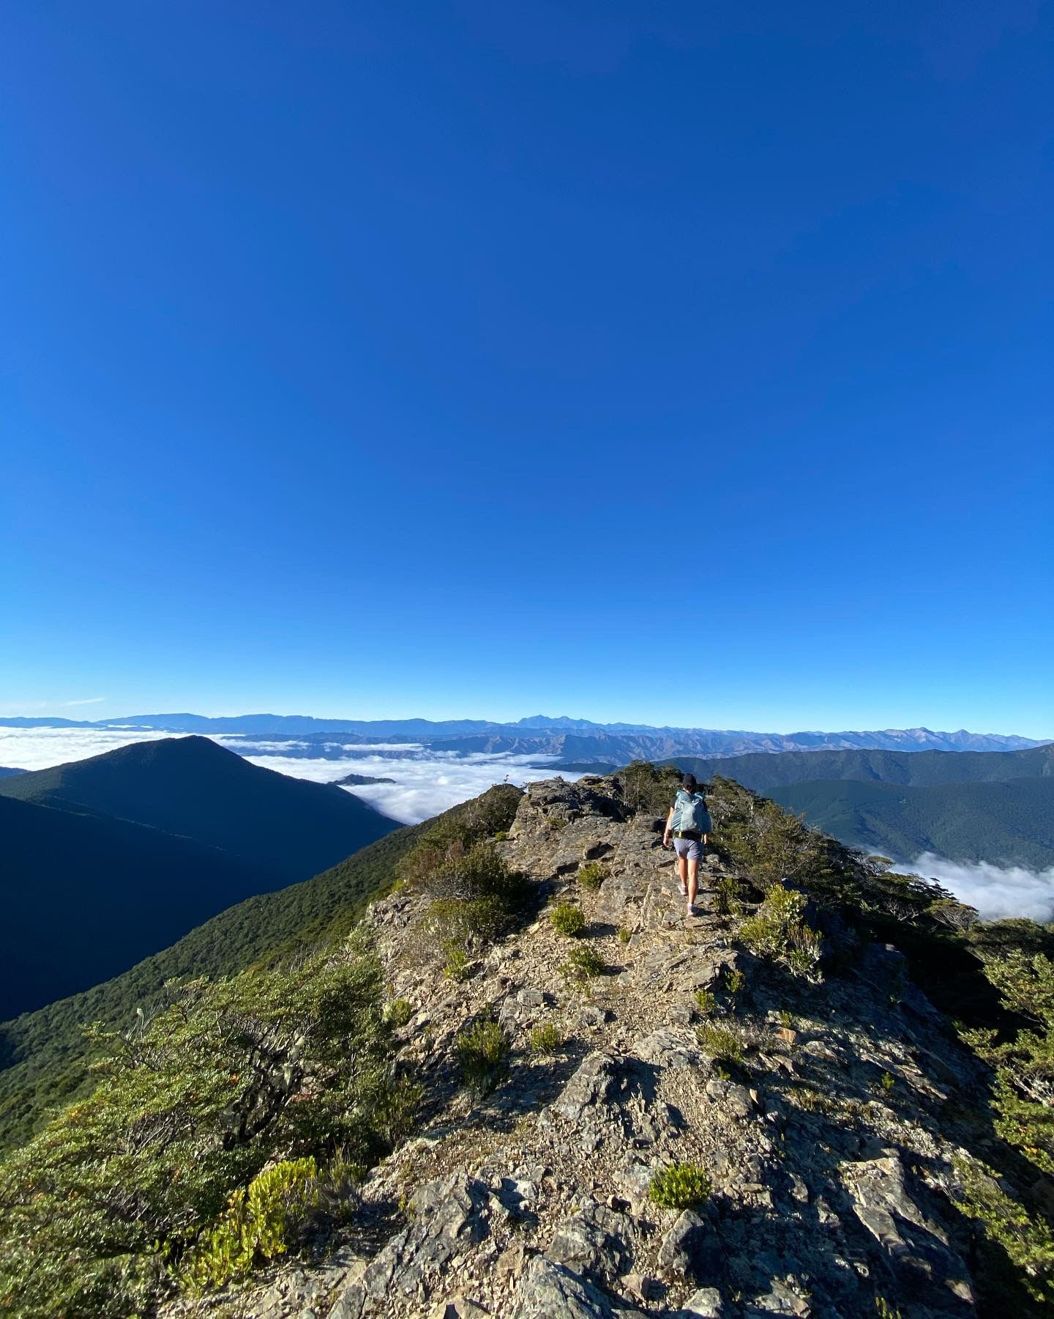
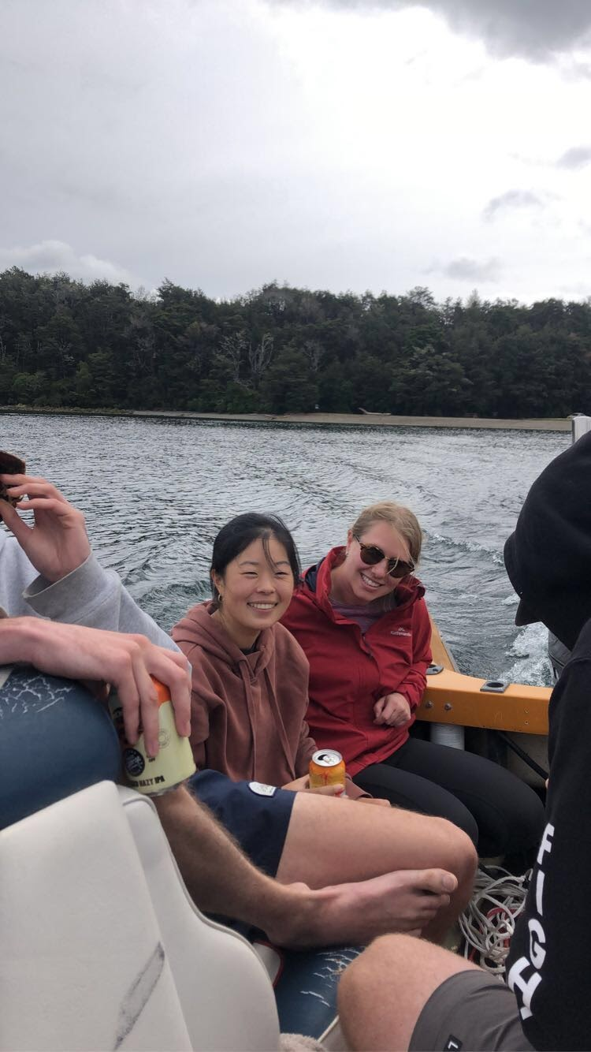
Come join us

